Slide 1
Quality Reimagined
COVID-19 Recovery Phase

Slide 2
Policy Areas of Review
Masking
Vaccine Mandate
Exposure
Testing

Slide 3
Masking

Slide 4
Masking Updates
Source Control Masking no longer required within the healthcare setting including unvaccinated workforce
April 3, 2023
Recommend “mask on” based on regional and national covid surveillance data for unvaccinated workforce
Contingent on Community Transmission (like flu – with executive decision to mask on if we see an increase in hospitalizations, death etc.)
Supportive Language to allow for optional masking and words that work when a patent requests masking
Staff preference
Patient preference
Specialty Areas

Slide 5
Unvaccinated Workforce
Staff with an approved exception Unvaccinated
Federal Law Requires:
Requiring staff who have not completed their primary vaccination series to follow additional, CDC-recommended precautions, such as adhering to universal source control and physical distancing measures in areas that are restricted from patient access (e.g., staff meeting rooms, kitchen), even if the facility or service site is located in a county with low to moderate community transmission.
Requiring at least weekly testing for exempted staff and staff who have not completed their primary vaccination series, until the regulatory requirement is met, regardless of whether the facility or service site is located in a county with low to moderate community transmission, in addition to following CDC recommendations for testing unvaccinated in facilities located in counties with substantial to high community transmission.
Requiring staff who have not completed their primary vaccination series to use a NIOSH approved N95 or equivalent or higher-level respirator for source control, regardless of whether they are providing direct care to or otherwise interacting with patients
NOTE: This requirement is not explicit and does not specify which actions must be taken. The examples above are not all inclusive and represent actions that can be implemented. However, facilities can choose other precautions that align with the intent of the regulation which is intended to “mitigate the transmission and spread of COVID-19 for all staff who are not fully vaccinated.”

Slide 6
Frequently Asked Questions
What if a patient asks me to wear a mask?
What if I want to wear a mask?
Why did we decide to do this?

Slide 7
Community Transmission

Slide 8
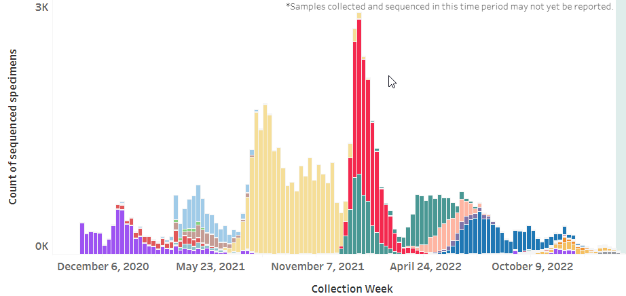
Oregon Variants Over time
https://public.tableau.com/profile/oregon.health.authority.covid.19#!/vizhome/GISAIDVariantDashboardUpdated/OregonVariantDashboard

Slide 9
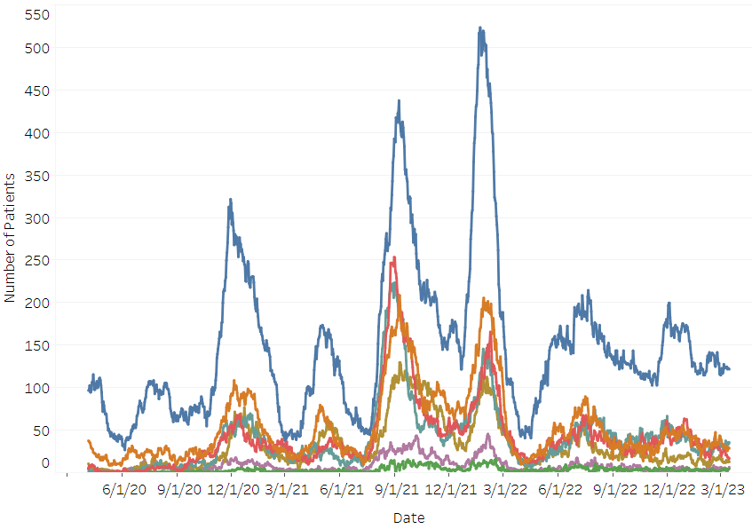
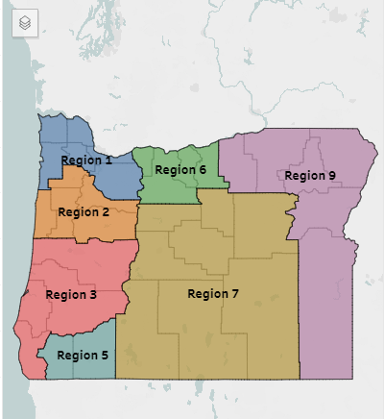
HOSCAP Regional Trends
https://public.tableau.com/app/profile/oregon.health.authority.covid.19/viz/OregonCOVID-19HospitalCapacity/HospitalizationbyRegion

Slide 10
Case & Hospitalization Rates

Slide 11
Trends in Asante COVID-19 Occupancy

Slide 12
Trends in COVID-19 & Influenza
* Closed mobile testing site

Slide 13
Exposure Notification

Slide 14
What is changing?
Asante will resume following transmission-based isolation precautions per policy and no longer will monitor COVID-19 exposures or quarantine asymptomatic patients.
Leaders’ COVID-19 exposure notifications end April 3.
COVID-exposure pay for staff ends April 3. (See HR 65 processes.)
Staff return-to-work process will follow Employee Health policies. (See EH policies for details.)

Slide 15
Universal Testing: Patients

Slide 16
What is changing?
Beginning Tuesday, April 4, universal screening and testing of asymptomatic patients for inpatient and outpatient admissions or procedures will be stopped.
Asante will transition to testing symptomatic individuals only for determining a differential diagnosis by the provider.
Two covid-19 screening questions will go away – list of symptoms will not

Slide 17
Other questions…. Concerns…

